Slide 1
Lecture Knowledge-based Systems Sentence/Paragraph/Document/… Similarity
Piush Aggarwal
Andrea Horbach
Torsten Zesch
Language Technology Lab
Universität Duisburg-Essen

Slide 2
Recap: Semantic Relatedness Measures
0.9
tree
willow
0.1
tree
car
Quantify the strength of semantic relatedness [0,1]

Slide 3
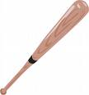
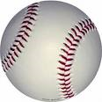
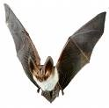
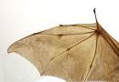
Recap: Semantic Relatedness & Senses
bat
ball
bat
wing
Notes:
Challenge in natural language: ambiguity

Slide 4
Outline
Introduction
Comparison Based
Measure of Text Similarity
Syntactical Based
Evaluation
Latent Semantical Based
Knowledge Based
Compositional Approaches
Distributional Based
Distributional Based
Non-compositional Approaches
Contextual Based
Overview

Slide 5
What makes two texts similar?
Beijing has abruptly withdrawn a new car registration system after drivers demonstrated "an unhealthy fixation" with symbols of Western military and industrial strength - such as FBI and 007. Senior officials have been infuriated by a popular demonstration of interest in American institutions such as the FBI. Particularly galling was one man's choice of TMD, which stands for Theatre Missile Defence, a US-designed missile system that is regularly vilified by Chinese propaganda channels.
The Russian defense minister said residents shouldn't feel threatened by the growing number of Chinese workers seeking employment in the country's sparsely populated Far Eastern and Siberian regions. There are no exact figures for the number of Chinese working in Russia, but estimates range from 200,000 to as many as 5 million. Most are in the Russian Far East, where they arrive with legitimate work visas to do seasonal work on Russia's low-tech, labor-intensive farms.
Lee et al. (2005)

Slide 6
What makes two texts similar?
Beijing has abruptly withdrawn a new car registration system after drivers demonstrated "an unhealthy fixation" with symbols of Western military and industrial strength - such as FBI and 007. Senior officials have been infuriated by a popular demonstration of interest in American institutions such as the FBI. Particularly galling was one man's choice of TMD, which stands for Theatre Missile Defence, a US-designed missile system that is regularly vilified by Chinese propaganda channels.
The Russian defense minister said residents shouldn't feel threatened by the growing number of Chinese workers seeking employment in the country's sparsely populated Far Eastern and Siberian regions. There are no exact figures for the number of Chinese working in Russia, but estimates range from 200,000 to as many as 5 million. Most are in the Russian Far East, where they arrive with legitimate work visas to do seasonal work on Russia's low-tech, labor-intensive farms.
China, car registration system
Chinese workers on Russian farms
Lee et al. (2005)

Slide 7
What about texts?
Words
“hit … bat … ball” & “ball … hit …bat.”
Topics
“Chinese officials have …” [China, gov’t] & “Beijing has …“ [China, gov’t]
Syntactic structure
“The book is on the table.” & “The cat is on the mat.” & “There is a black-silverish book lying on the desk.”
Style
“Even a liar can be scared into telling the truth, same as an honest man can be tortured into telling a lie.” & “Sin and love and fear are just sounds that people who never sinned nor loved nor feared have for what they never had and cannot have until they forget the words.”
Author
“Shall I compare thee to a summer’s day?” & “To be, or not to be, - that is the question.“
Notes:
Easier for words.
domain specificity is a problem
Opera – browser
Opera – singer

Slide 8
Applications of Text Similarity
Information retrieval (Query vs. Document)‏
Text classification (Document vs. Category)‏
Word-sense disambiguation (Context vs. Context)
Plagiarism Detection (Document vs. Plagiarized Document)
Automatic evaluation
Machine translation (Gold Standard vs. Generated)‏
Text summarization (Summary vs. Original)‏
Slide adapted from Rada Mihalcea

Slide 9



Real World Use Cases – Q&A
Question-and-Answer sites such as Quora or Stackoverflow need to determine whether a question has already been asked before.

Slide 10
Legal Matters
To mitigate risks on a new contract, based on the assumption that if a new contract is similar to a existent one that has been proved to be resilient, the risk of this new contract being the cause of financial loss is minimised.
Case Law principle : Automatic linking of related documents ensures that identical situations are treated similarly in every case.
Fairness and equality.
Notes:
Precedence retrieval of legal documents is an information retrieval task to retrieve prior case documents that are related to a given case document.

Slide 11

Customer Services
if the user asks “What has happened to my delivery?” or “What is wrong with my shipping?”, the user will expect the same response.

Slide 12



Other Use Cases
Job-posting Resume Matching
Recommender Systems
Many more..

Slide 13
Outline
Introduction
Comparison Based
Measure of Text Similarity
Syntactical Based
Evaluation
Latent Semantical Based
Knowledge Based
Compositional Approaches
Distributional Based
Distributional Based
Non-compositional Approaches
Contextual Based
Overview

Slide 14
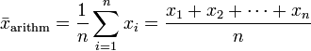
Comparison
Compositional Measures
Non-compositional Measures
0.8
0.6
0.8
0.3
0.9
Bag of Words Pairwise Matching Aggregation
Representation of whole texts Similarity computation

Slide 15
Comparison
Compositional Measures
Non-compositional Measures
0.8
0.6
0.8
0.3
0.9
Bag of Words Pairwise Matching Aggregation
Representation of whole texts Similarity computation

Slide 16
Compositional Measures Step 1: Bag of Words
Text 1 Text 2
Tom
hit
the
ball
The
baseball
was
hit
Tom hit the ball with the bat.
The baseball was hit by the stick.
with
the
bat
.
by
the
stick
.
Lemmatization, Stopword list, Case normalization
bat
ball
Tom
hit
baseball stick
hit
be

Slide 17
Compositional Measures Step 2: Pairwise Matching
0.8
0.8
bat
ball
Tom
hit
baseball stick
hit
be
0.3
0.3
0.1
0.1
0.1
0.1
Compute all pairwise similarity scores bat – baseball, bat – stick, bat – hit, bat – be ball – baseball, ball – stick, ball – hit, ball – be etc.
Pair those tokens with the highest similarity scores, e.g. ball – baseball

Slide 18
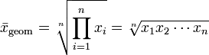
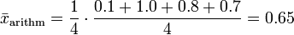
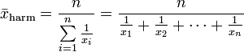
Compositional Measures Step 3: Aggregation
Tom
0.1
be
hit
1.0
hit
ball
0.8
baseball
bat
0.7
stick
Aggregation into a single text similarity figure
e.g. Arithmetic Mean … or others

Slide 19
Compositional Measures Summary
0.65
Tom hit the ball with the bat.
The baseball was hit by the stick.
Create a Bag of Words representation
Perform a pairwise matching
Aggregate the term similarity scores to a single text similarity figure

Slide 20
Bag of Words Model Drawbacks
Common words influence the similarity too much
“The king is here.” vs. “The salad is cold.”
Solution: Stopword lists and/or tf.idf ranking
Negation and Antonymy
„I like pizza.“ vs „I don't like pizza.“
„I ran the marathon very quickly.“ vs „I ran the marathon slowly.“
Semantic role reversal
“Dog bites man.” vs “Man bites dog.”
Ignores semantic similarities
“I own a dog.” vs. “I have a pet.”
Ignores semantic frames/roles
“Yahoo bought Flickr.” vs. “Flickr was sold to Yahoo.”

Slide 21
Comparison
Compositional Measures
Non-compositional Measures
0.8
0.6
0.8
0.3
0.9
Bag of Words Pairwise Matching Aggregation
Representation of whole texts Similarity computation

Slide 22
Non-compositional Measures
?
Step 1: Abstract whole texts to a global representation
Step 2: Compute text similarity on these representations
Notes:
Reference Algorithms
Explicit Semantic Analysis (extension to texts) (Gabrilovich & Markovitch, 2007)
Random Graph Walks (Ramage et al., 2009, Yeh et al., 2009)
ADD Para2vec/doc2vec etc.

Slide 23
Explicit Semantic Analysis for Texts (I)
(Gabrilovich & Markovitch, 2007)
He hit the ball with the bat.
 | t₁ | t₂ | t₃ | … | t_{m-1} | t_{m}
d₁ | 3 | 1 | 0 | … | 0 | 0
d₂ | 0 | 5 | 0 | … | 1 | 0
d₃ | 1 | 0 | 2 | … | 3 | 3
… | … | … | … | … | … | …
d_{n-1} | 0 | 2 | 3 | … | 2 | 1
d_{n} | 2 | 3 | 0 | … | 5 | 0
Notes:
Concept vector based measures can also be visualized using the term-document matrix.
However, we now use term vectors instead of document vectors.

Slide 24
Explicit Semantic Analysis for Texts (II)
 | t₁ | t₂ | t₃ | … | t_{m-1} | t_{m}
d₁ | 3 | 1 | 0 | … | 0 | 0
d₂ | 0 | 5 | 0 | … | 1 | 0
d₃ | 1 | 0 | 2 | … | 3 | 3
… | … | … | … | … | … | …
d_{n-1} | 0 | 2 | 3 | … | 2 | 1
d_{n} | 2 | 3 | 0 | … | 5 | 0
c₁
c₂
c₃
c_{n-1}
c_{n}
4
5
4
…
3
5
Combine vectors
Additive
Multiplicative
Notes:
Concept vector based measures can also be visualized using the term-document matrix.
However, we now use term vectors instead of document vectors.

Slide 25
Explicit Semantic Analysis for Texts (III)
Document 1
Document 2
 | t₁ | t₂ | t₃ | … | t_{m-1} | t_{m}
d₁ | 3 | 1 | 0 | … | 0 | 0
d₂ | 0 | 5 | 0 | … | 1 | 0
d₃ | 1 | 0 | 2 | … | 3 | 3
… | … | … | … | … | … | …
d_{n-1} | 0 | 2 | 3 | … | 2 | 1
d_{n} | 2 | 3 | 0 | … | 5 | 0
 | t₁ | t₂ | t₃ | … | t_{m-1} | t_{m}
d₁ | 3 | 1 | 0 | … | 0 | 0
d₂ | 0 | 5 | 0 | … | 1 | 0
d₃ | 1 | 0 | 2 | … | 3 | 3
… | … | … | … | … | … | …
d_{n-1} | 0 | 2 | 3 | … | 2 | 1
d_{n} | 2 | 3 | 0 | … | 5 | 0
4
5
4
…
3
5
3
0
4
…
1
2
Inner product
(e.g. cosine similarity)
sim(d₁,d₂) = 0.59
Notes:
Concept vector based measures can also be visualized using the term-document matrix.
However, we now use term vectors instead of document vectors.

Slide 26
Outline
Introduction
Comparison Based
Measure of Text Similarity
Syntactical Based
Evaluation
Latent Semantical Based
Knowledge Based
Compositional Approaches
Distributional Based
Distributional Based
Non-compositional Approaches
Contextual Based
Overview

Slide 27
Evaluating Text Similarity
Evaluation is systematic determination of merit, worth, and significance of something or someone using criteria against a set of standards.
?

Slide 28
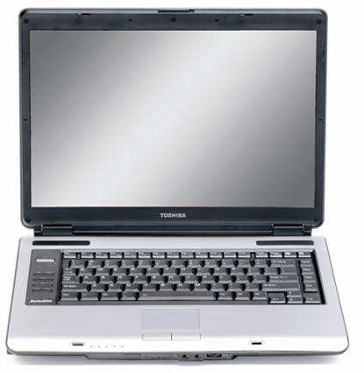


Evaluation Process – Word Similarity
Ø
tree – lake
0.5
0.5
0.75
0.58
0.7
tree – willow
0.75
0.75
1.0
0.83
0.9
tree – car
0.25
0.0
0.0
0.08
0.0
Correlation coefficient (Pearson / Spearman)
Notes:
For the evaluation process, we need human judgments of SR as a reference.
present word pairs

Slide 29
When are two texts similar?
Beijing has abruptly withdrawn a new car registration system after drivers demonstrated "an unhealthy fixation" with symbols of Western military and industrial strength - such as FBI and 007. Senior officials have been infuriated by a popular demonstration of interest in American institutions such as the FBI. Particularly galling was one man's choice of TMD, which stands for Theatre Missile Defence, a US- designed missile system that is regularly vilified by Chinese propaganda channels.
The Russian defense minister said residents shouldn't feel threatened by the growing number of Chinese workers seeking employment in the country's sparsely populated Far Eastern and Siberian regions. There are no exact figures for the number of Chinese working in Russia, but estimates range from 200,000 to as many as 5 million. Most are in the Russian Far East, where they arrive with legitimate work visas to do seasonal work on Russia's low-tech, labor-intensive farms.
China, car registration system
0.56
Chinese workers on Russian farms
Notes:
Average human similarity judgment for these two example texts.

Slide 30
Evaluating Text Similarity
Evaluation is systematic determination of merit, worth, and significance of something or someone using criteria against a set of standards.
Judging similarity between texts is difficult
No definite gold standard (“ground truth”)
Usually evaluated as part of a certain task

Slide 31
SemEval 2012 – Semantic Text Similarity
A man and a woman are kissing each other.
A man and a woman are talking to each other.
A girl dances in the rain.
A woman is dancing in the rain.
0.6
3.0

Slide 32
SemEval 2012 – Semantic Text Similarity
A man is riding a bike.
A man is riding a bicycle.
Two people are riding a motorcycle.
Two people are riding a bike.
5.0
2.0

Slide 33
BLEU Score (Papineni, et al. 2002)
Also known as Bilingual Evaluation Understudy Score
Metric for evaluating a generated sentence to a reference sentence.
A perfect match results in a score of 1.0, whereas a perfect mismatch results in a score of 0.0.
Measure the Automatic machine translation performance.
Proposed idea: The closer a machine translation is to a professional human translation, the better it is.

Slide 34
Example
MT Candidate 1: It is a guide to action which ensures that the military always obeys the commands of the party.
MT Candidate 2: It is to insure the troops forever hearing the activity guidebook that party direct.
Reference 1: It is a guide to action that ensures that the military will forever heed Party commands.
Reference 2: It is the guiding principle which guarantees the military forces always being under the command of the Party.
Reference 3: It is the practical guide for the army always to heed the directions of the party.

Slide 35
Observation
MT Candidate 1 shares
"It is a guide to action" with Reference 1,
"which" with Reference 2,
"ensures that the military" with Reference 1,
"always" with References 2 and 3,
"commands" with Reference 1,
"of the party" with Reference 2
In contrast, MT Candidate 2 exhibits far fewer matches and their extent is less.
Conclusion: MT Candidate 1, shares many words and phrases with these three reference translations, while MT Candidate 2 does not.

Slide 36
Bleu Score
It compare n-grams of the candidate with the n-grams of the reference translation and count the number of matches.
n value of n-grams should be choosen wisely.
For example:
Candidate: the the the the the the the.
Reference 1: The cat is on the mat.
Reference 2: There is a cat on the mat.
In this example, in case of unigram candidate generate high blue score.

Slide 37
Rouge Score (Chin-Yew Lin, 2004)
Stands for “Recall-Oriented Understudy for Gisting Evaluation“.
Generally used to evaluate automatic text summarization systems or machine translation tasks.
Computed using the precision and recall using the overlap terms between two documents.

Slide 38
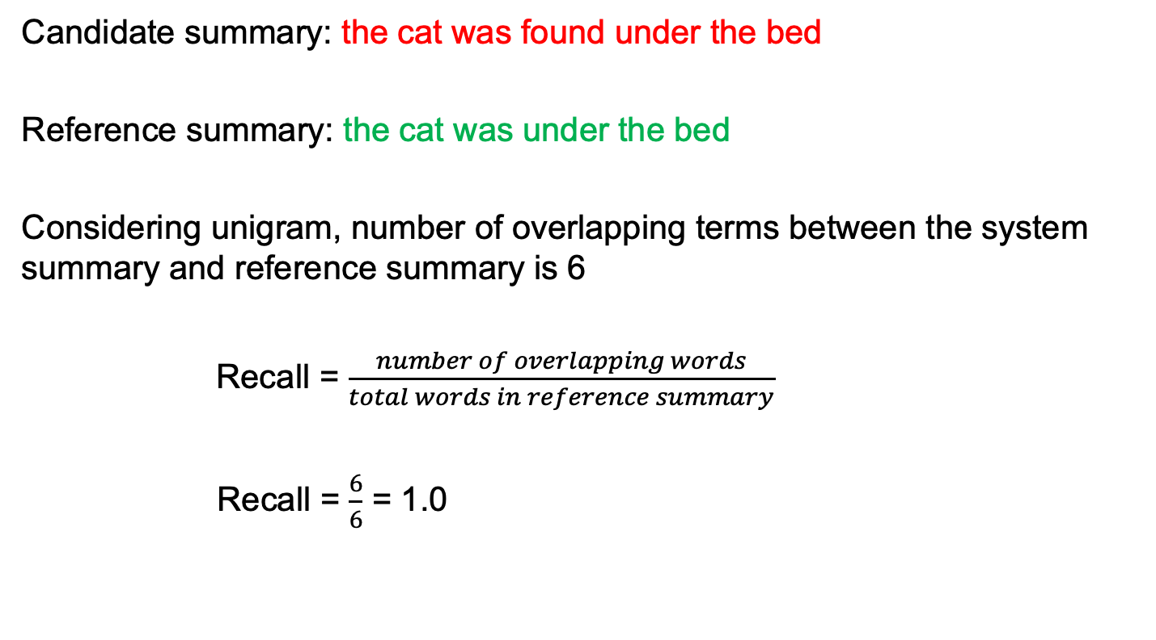
Example
Candidate summary: the cat was found under the bed
Reference summary: the cat was under the bed
Considering unigram, number of overlapping terms between the system summary and reference summary is 6
Recall = $\frac{number of overlapping words}{total words in reference summary}$
Recall = $\frac{6}{6}$ = 1.0

Slide 39
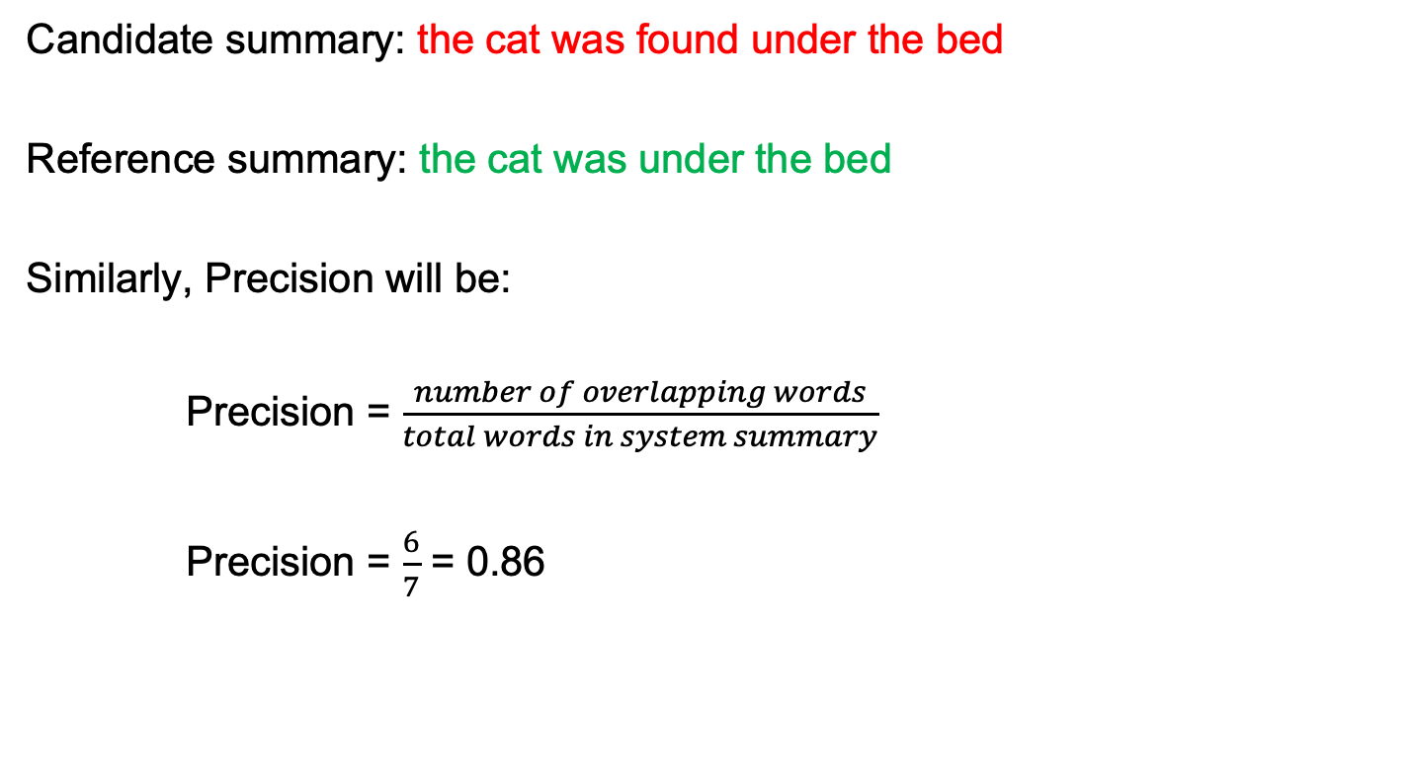
Example
Candidate summary: the cat was found under the bed
Reference summary: the cat was under the bed
Similarly, Precision will be:
Precision = $\frac{number of overlapping words}{total words in system summary}$
Precision = $\frac{6}{7}$ = 0.86

Slide 40
Outline
Introduction
Comparison Based
Measure of Text Similarity
Syntactical Based
Evaluation
Latent Semantical Based
Knowledge Based
Compositional Approaches
Distributional Based
Distributional Based
Non-compositional Approaches
Contextual Based
Overview

Slide 41
Compositional Measure
0.8
0.6
0.8
0.3
0.9
Bag of Words Pairwise Matching Aggregation

Slide 42
Pairwise Matching
bat
ball
Tom
hit
baseball stick
hit
be

Slide 43
Outline
Introduction
Comparison Based
Measure of Text Similarity
Syntactical Based
Evaluation
Latent Semantical Based
Knowledge Based
Compositional Approaches
Distributional Based
Distributional Based
Non-compositional Approaches
Contextual Based
Overview

Slide 44
Jaccard Similarity
Jaccard similarity or intersection over union is defined as size of intersection divided by size of union of two sets.
Let’s take example of two sentences:
Sentence 1: AI is our friend and it has been friendly
Sentence 2: AI and humans have always been friendly
Notes:
In our case, “friend” and “friendly” will both become “friend”, “has” and “have” will both become “has”.

Slide 45
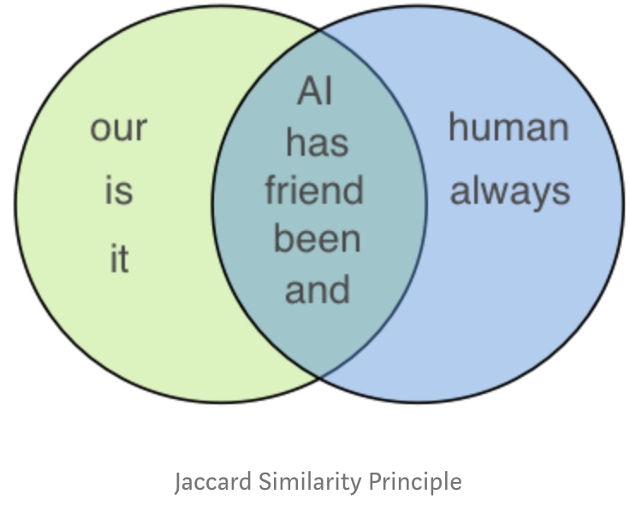
Jaccard Similarity
For the above two sentences, we get Jaccard similarity of 5/(5+3+2) = 0.5 which is size of intersection of the set divided by total size of set.
Note: we usually perform lemmatization to reduce words to the same root word.
Notes:
https://gist.github.com/adsieg/f33430c62adf0185cbb1a176e3a3820b/raw/41068b95f9c30acdee9f4f5d24effcbf1feca4ca/JaccardSimilarity.py

Slide 46
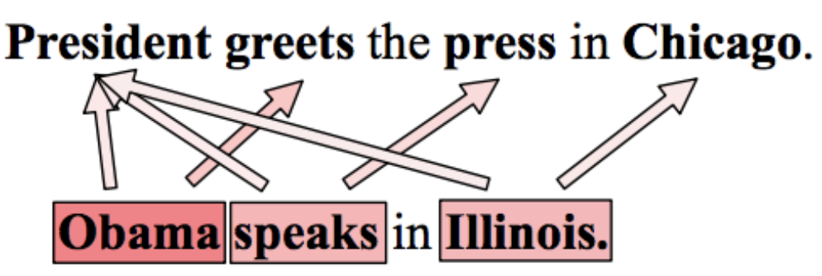
Why Jaccard Similarity is not efficient?
This measure is neither able to capture semantic similarity nor lexical semantic of these two sentences.

Slide 47
Outline
Introduction
Comparison Based
Measure of Text Similarity
Syntactical Based
Evaluation
Latent Semantical Based
Knowledge Based
Compositional Approaches
Distributional Based
Distributional Based
Non-compositional Approaches
Contextual Based
Overview

Slide 48
Knowledge Based Methods
Some of the best performing text similarity measures don’t use vectors at all.
This is the case of the winner system in SemEval2014 sentence similarity task which uses lexical word alignment.
Notes:
symmetric

Slide 49





Examples

Slide 50
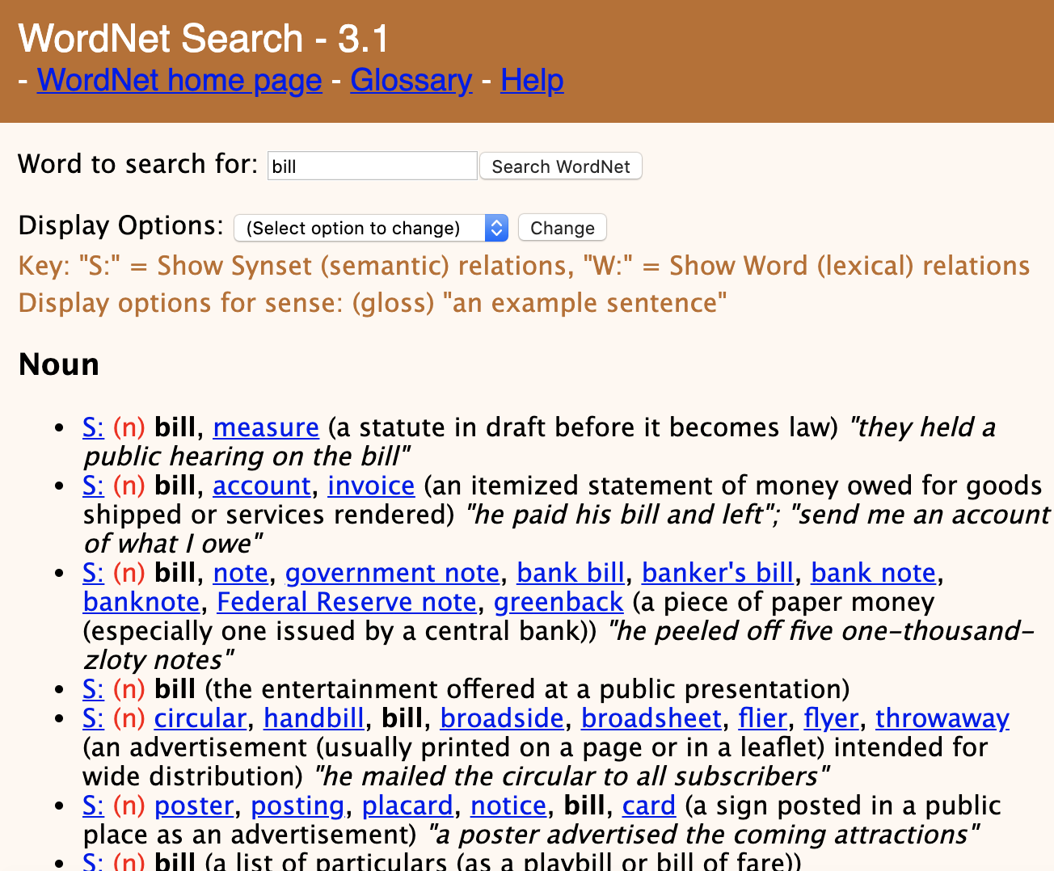
Wordnet

Slide 51
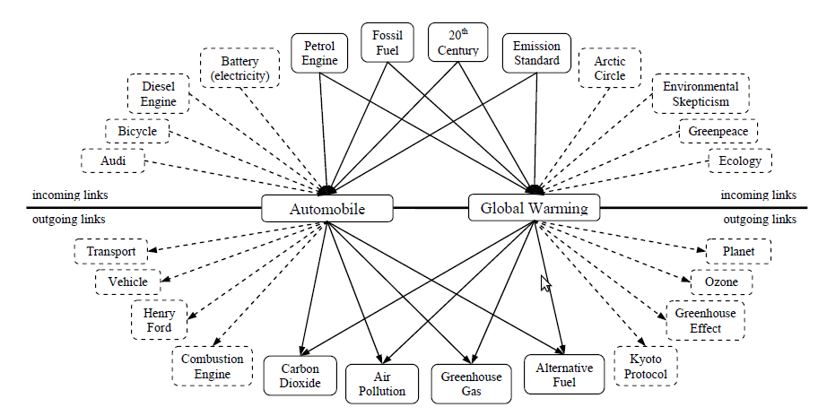
Example
Milne & Witten, 2008
Notes:
Wikipedia articles have links.
Intuition: Articles with many shared links are related.

Slide 52
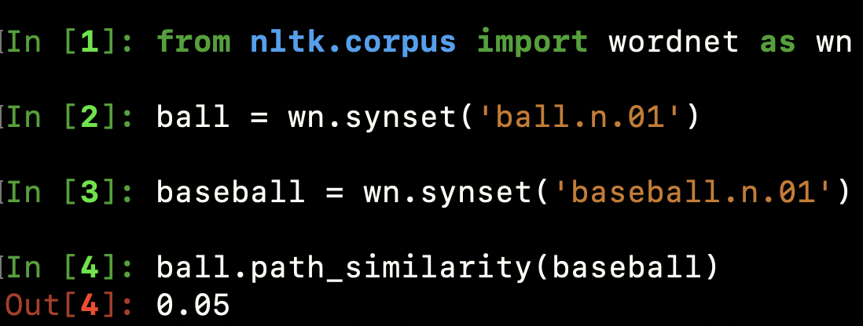
Using Knowledge Based Methods
Use knowledge source and get the similarity score between the terms.
0.05
0.8
bat
ball
Tom
hit
baseball stick
hit
be
0.3
0.3
0.1
0.1
0.1
0.1

Slide 53
Drawbacks of Knowledge Based Methods
Not every language has large knowledge bases.
They are often quite incomplete.

Slide 54
Outline
Introduction
Comparison Based
Measure of Text Similarity
Syntactical Based
Evaluation
Latent Semantical Based
Knowledge Based
Compositional Approaches
Distributional Based
Distributional Based
Non-compositional Approaches
Contextual Based
Overview

Slide 55
Distributional Approach
[Firth, 1957]
“You shall know a word by the company it keeps.”
[Lin, 1998] after [Nida, 1975]
A bottle of tezgüino is on the table
Everybody likes tezgüino
Tezgüino makes you drunk
We make tezgüino out of corn.
Intuition:
Just from these contexts, a human could guess the meaning of tezgüino.
Thus, we should look at the surrounding contexts, see what other words have similar context.
What is “tezgüino”?

Slide 56
Word2Vec (Mikolov et al., 2013)
...
wiegen 0.0427915 -0.401344 -0.0667862 0.21649 0.00169907 -0.0687786 -0.195405 -0.0534437 -0.676733 -0.23975 -0.159674 -0.0402676 -0.0617923 0.284718 0.358523 -0.285709 -0.00736682 -0.254635 -0.22907 -0.186109 ...
einlegen 0.365857 -0.0339146 0.198442 -0.0961315 0.156193 0.253468 0.169963 -0.232588 -0.422901 -0.0750184 0.0236783 0.249385 -0.0122247 -0.584567 -0.0711365 0.254896 0.382103 0.352294 0.825432 0.277691 0.773015 ...
sprengstoff 0.06961 0.118456 0.00497905 0.581913 -0.326157 -0.0674812 -0.0926074 -0.254514 -0.458406 -0.225093 0.0424881 -0.142328 -0.138707 0.481305 0.183707 -0.626077 0.396159 0.156636 0.157851 -0.441935...
vulkan 0.0322022 -0.429981 0.352328 -0.0530384 -0.366048 0.44187 -0.265227 -0.223954 -0.369078 -0.203064 0.158458 0.169517 0.448234 0.497058 -0.20855 0.046978 0.180444 0.290595 0.00907329 0.130582 0.0378717 -0.339296 0.399039...
...
Notes:
Examples from Nils vocab file
Make the point: How do we know this is useful? Not interpretable. And what do we do with it?

Slide 57
Word vectors
“One-hot” vector, sparse representation
Dimensionality of vector equals size of vocabulary
Notes:
Ask is there a problem with this representation?

Slide 58
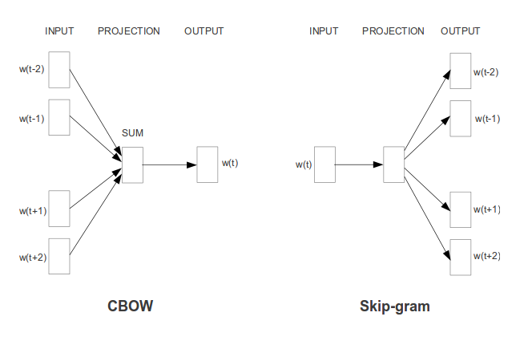
CBOW vs Skip-gram

Slide 59
CBOW vs Skip-gram
1-hot vectors

Slide 60
CBOW vs Skip-gram
“1-hot“ vectors or probability for each word
Notes:
Das ist eine vereinfachte Darstellung. In der Implementierung ist es eher so, dass wir eine Wahrscheinlichkeitsverteilung über die target words haben und bei CBOW wird das beste genommen und bei Skip-gram, die besten n (je nach Größe des Kontext Windows, Word Order wird ja nicht modelliert)

Slide 61
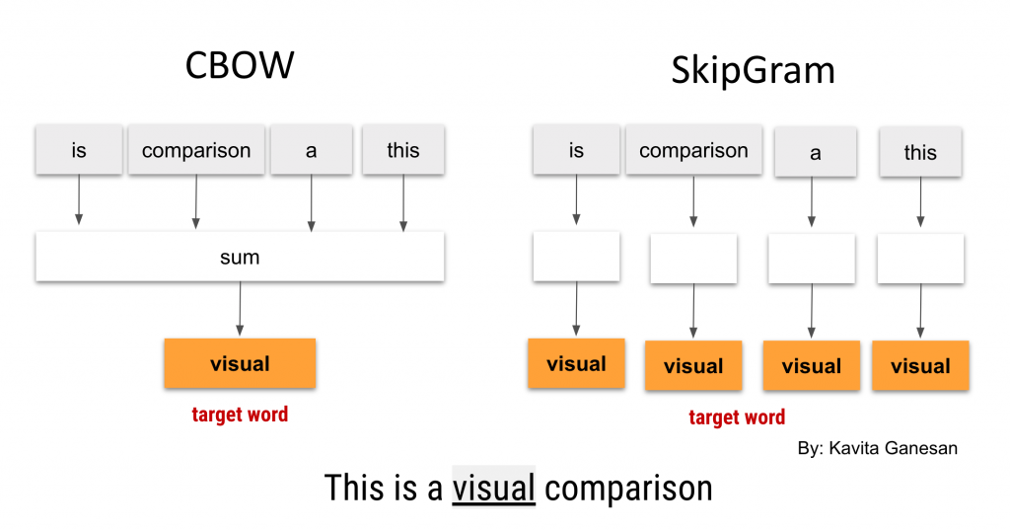
CBOW vs Skip-gram
Notes:
Das ist eine vereinfachte Darstellung. In der Implementierung ist es eher so, dass wir eine Wahrscheinlichkeitsverteilung über die target words haben und bei CBOW wird das beste genommen und bei Skip-gram, die besten n (je nach Größe des Kontext Windows, Word Order wird ja nicht modelliert)

Slide 62
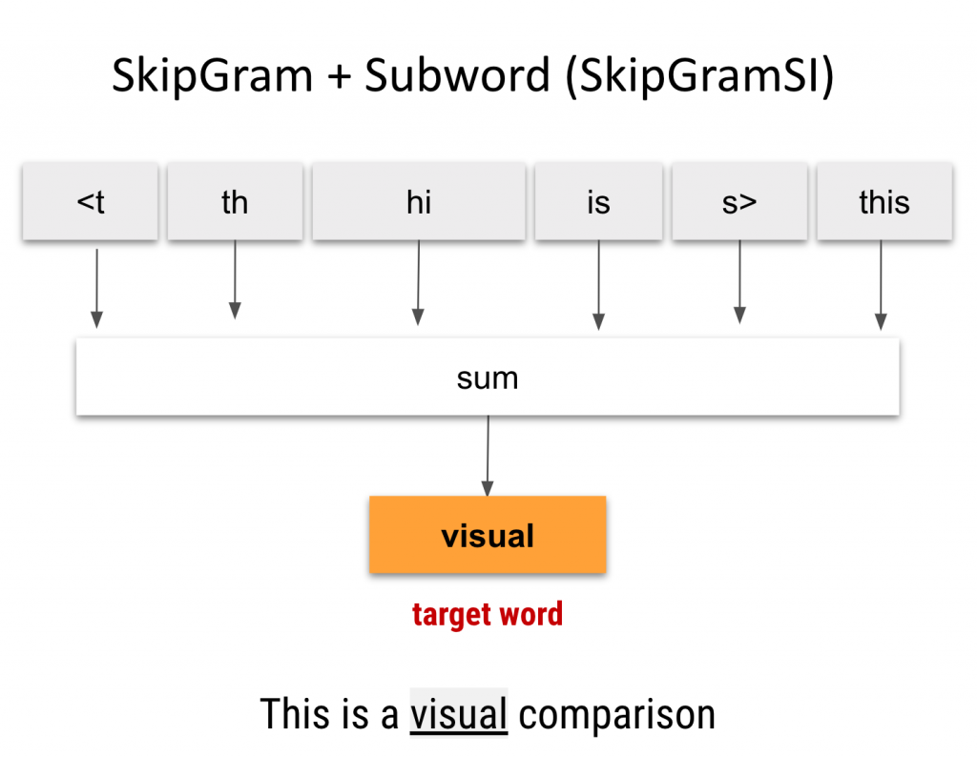
CBOW vs Skip-gram
Notes:
Das ist eine vereinfachte Darstellung. In der Implementierung ist es eher so, dass wir eine Wahrscheinlichkeitsverteilung über die target words haben und bei CBOW wird das beste genommen und bei Skip-gram, die besten n (je nach Größe des Kontext Windows, Word Order wird ja nicht modelliert)

Slide 63
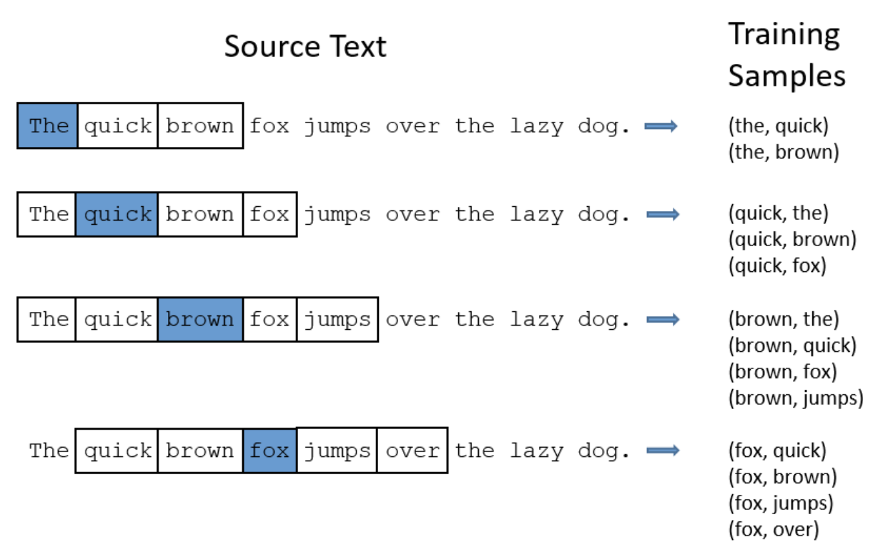
Training Samples
Window size : 2

Slide 64
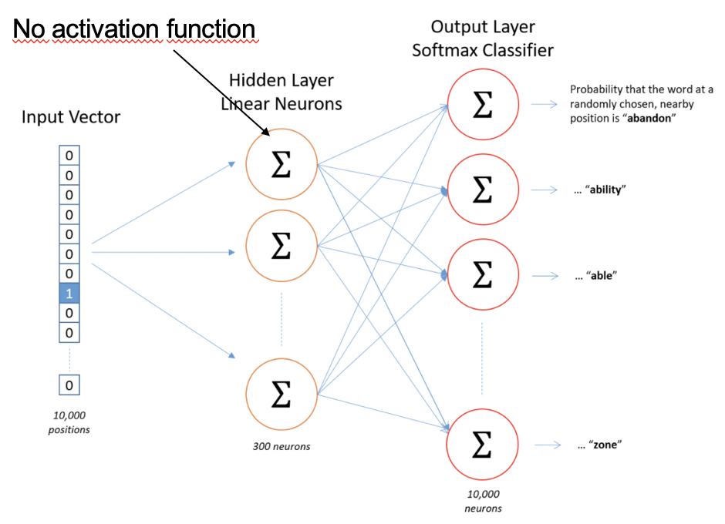
Training Model
McCormick, C. (2016, April 19). Word2Vec Tutorial - The Skip-Gram Model.

Slide 65
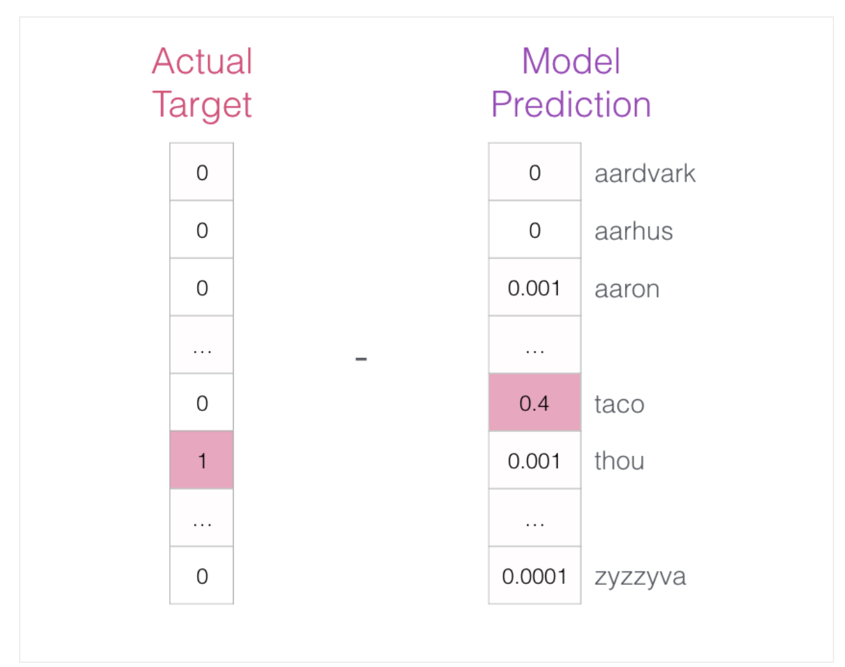
Hidden layer optimization – Step1

Slide 66
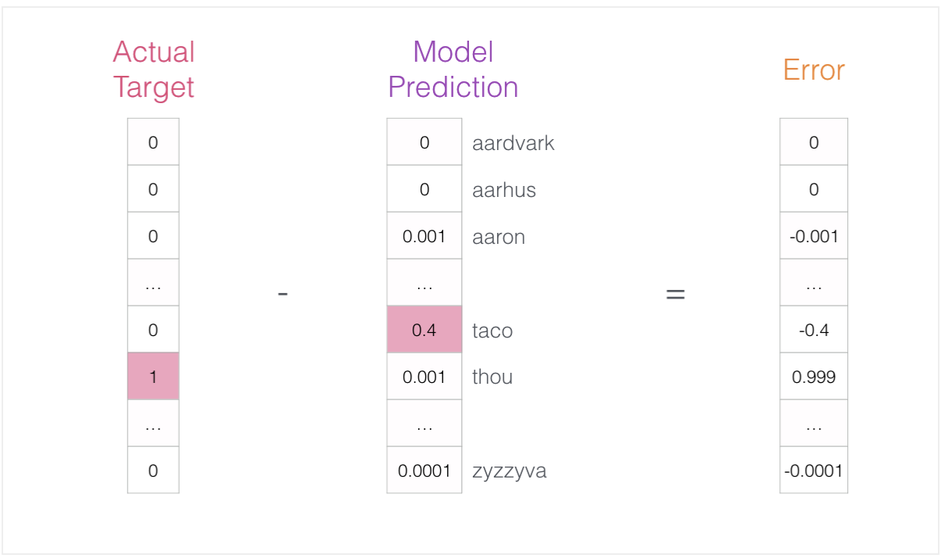
Hidden layer optimization – Step2

Slide 67
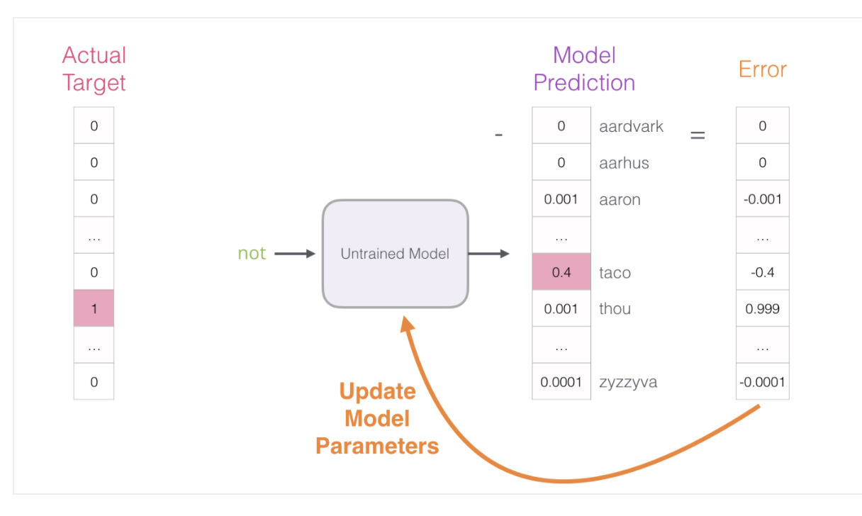
Hidden layer optimization – Step3

Slide 68
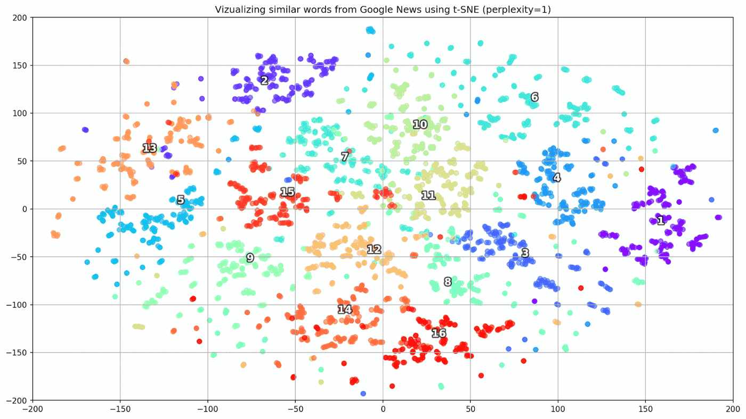
Visualization (16 semantically related words)

Slide 69
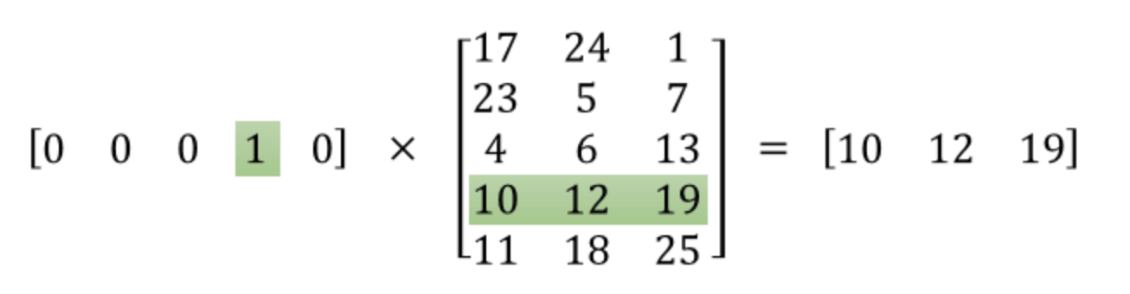
Embedding Vector
Term‘s Embedding Vector
Term
Hidden Layers

Slide 70
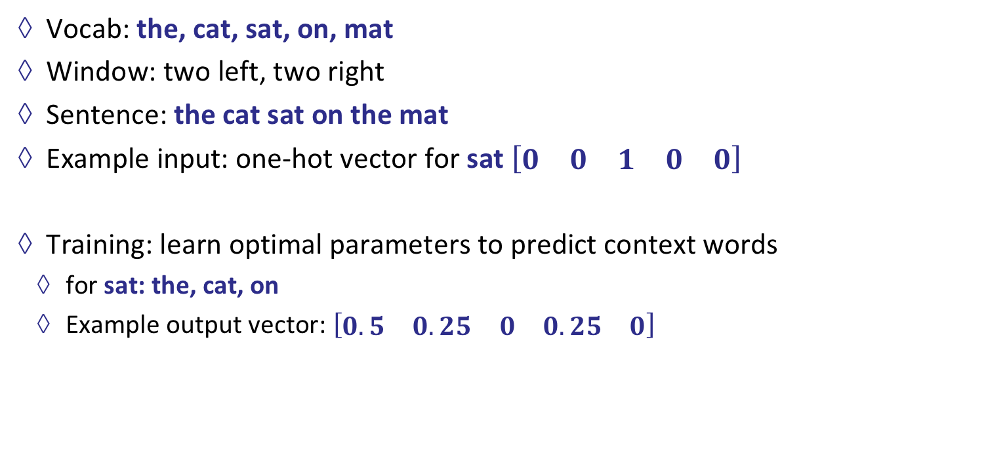
Toy example
Vocab: the, cat, sat, on, mat
Window: two left, two right
Sentence: the cat sat on the mat
Example input: one-hot vector for sat $\begin{matrix}\left[\begin{matrix}0 & 0 & 1 & 0 & 0\end{matrix}\right]\end{matrix}$
Training: learn optimal parameters to predict context words
for sat: the, cat, on
Example output vector: $\begin{matrix}\left[\begin{matrix}0.5 & 0.25 & 0 & 0.25 & 0\end{matrix}\right]\end{matrix}$
Notes:
Matrix ist fiktiv
0 * 0.14 + 0*-0.26 + 1 * 0.81 + 0 * 0.59 + 0 * 0.03

Slide 71
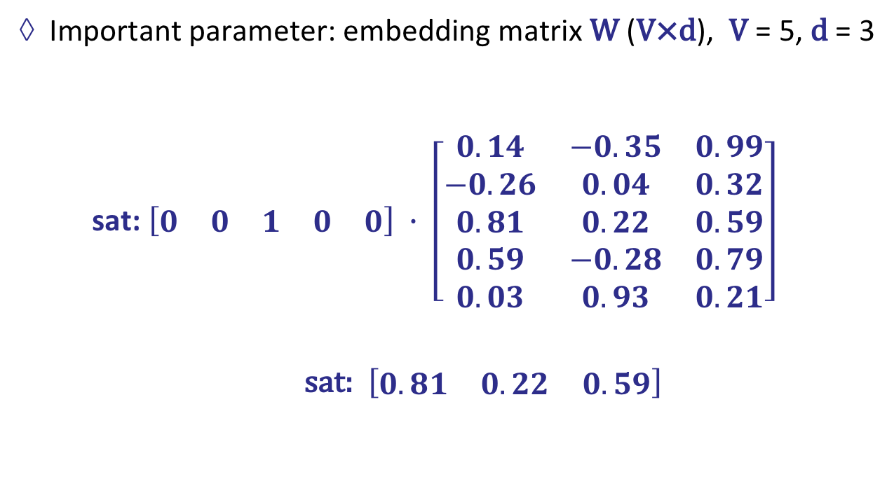
Toy example
Important parameter: embedding matrix W (V×d), V = 5, d = 3
sat: $\left[\begin{matrix}0 & 0 & 1 & 0 & 0\end{matrix}\right] ∙ \left[\begin{matrix}0.14 & −0.35 & 0.99 \\ −0.26 & 0.04 & 0.32 \\ 0.81 & 0.22 & 0.59 \\ 0.59 & −0.28 & 0.79 \\ 0.03 & 0.93 & 0.21\end{matrix}\right]$
sat: $\left[\begin{matrix}0.81 & 0.22 & 0.59\end{matrix}\right]$
Notes:
Matrix ist fiktiv
0 * 0.14 + 0*-0.26 + 1 * 0.81 + 0 * 0.59 + 0 * 0.03

Slide 72

Using Word2Vec
Compute the similarity score between embedding vectors for each pair.
For example :
0.8
0.8
bat
ball
Tom
hit
baseball stick
hit
be
0.3
0.3
0.1
0.1
0.1
0.1
ball
baseball
Embedding vectors
0.8
Cosine similarity

Slide 73
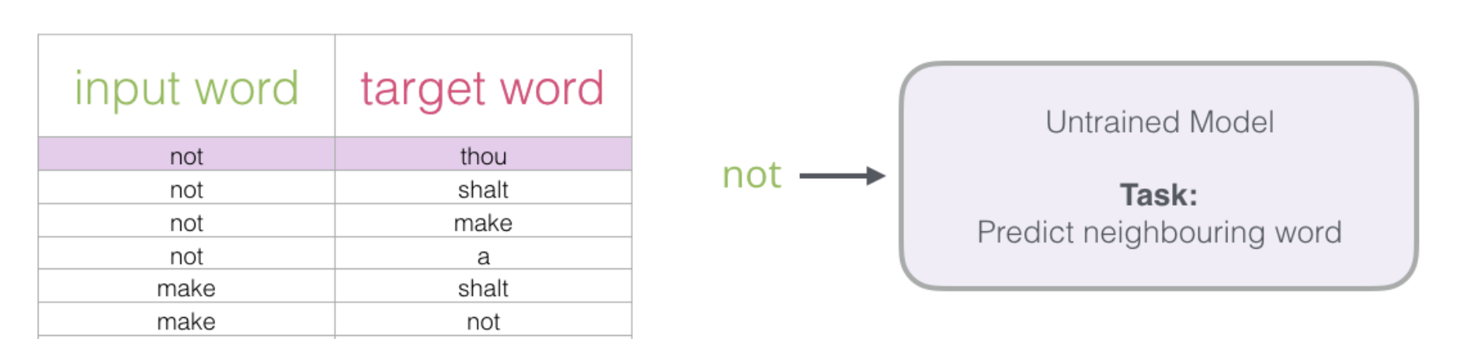
Computational overhead
Training a neural network means taking a training example and adjusting all of the neuron weights slightly so that it predicts that training sample more accurately. In other words, each training sample will tweak all of the weights in the neural network.
Example:

Slide 74
Negative Sampling
The size of our word vocabulary means that our neural network has a tremendous number of weights, all of which would be updated slightly by every one of our billions of training samples
Negative sampling addresses this by having each training sample only modify a small percentage of the weights, rather than all of them.

Slide 75
Before - Negative Sampling
1
0
0
0

Slide 76
After - Negative Sampling
1
0
X
0

Slide 77
Negative Sampling
Before:
When training the network on the word pair (“fox”, “quick”), recall that the “label” or “correct output” of the network is a one-hot vector. That is, for the output neuron corresponding to “quick” to output a 1, and for all of the other thousands of output neurons to output a 0.
After:
With negative sampling, we are instead going to randomly select just a small number of “negative” words (let’s say 5) to update the weights for. (In this context, a “negative” word is one for which we want the network to output a 0 for). We will also still update the weights for our “positive” word (which is the word “quick” in our current example).

Slide 78
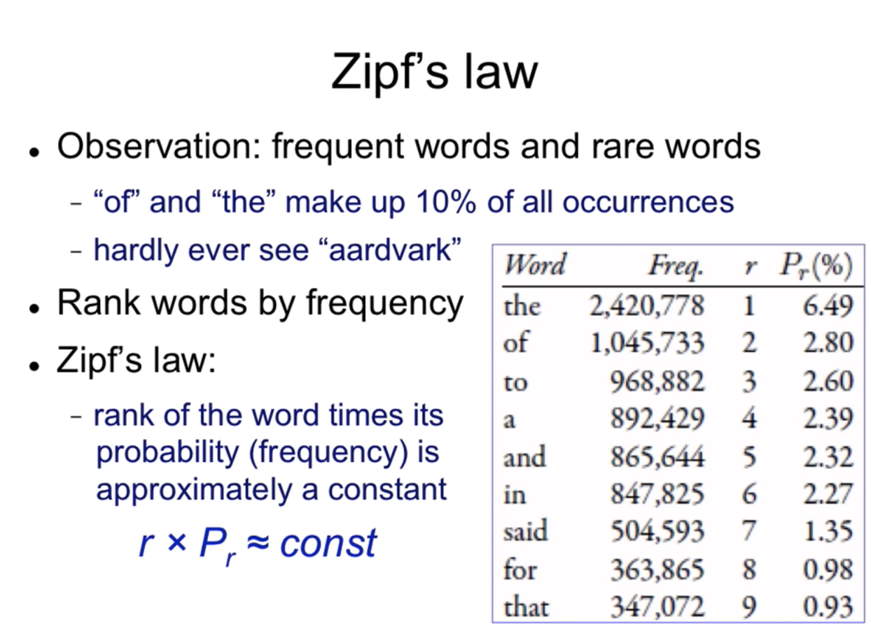
Negative Samples Selection
The “negative samples” (that is, the 5 output words that we’ll train to output 0) are selected using a “unigram distribution”, where more frequent words.

Slide 79
Word Mover’s Distance
I have 2 sentences:
Obama speaks to the media in Illinois
The president greets the press in Chicago
Removing stop words:
Obama speaks media Illinois
president greets press Chicago
Sparse vectors like count vectorizers for the 2 sentences have no common words and will have a cosine distance of 0.
This is a terrible distance score because the 2 sentences have very similar meanings.

Slide 80
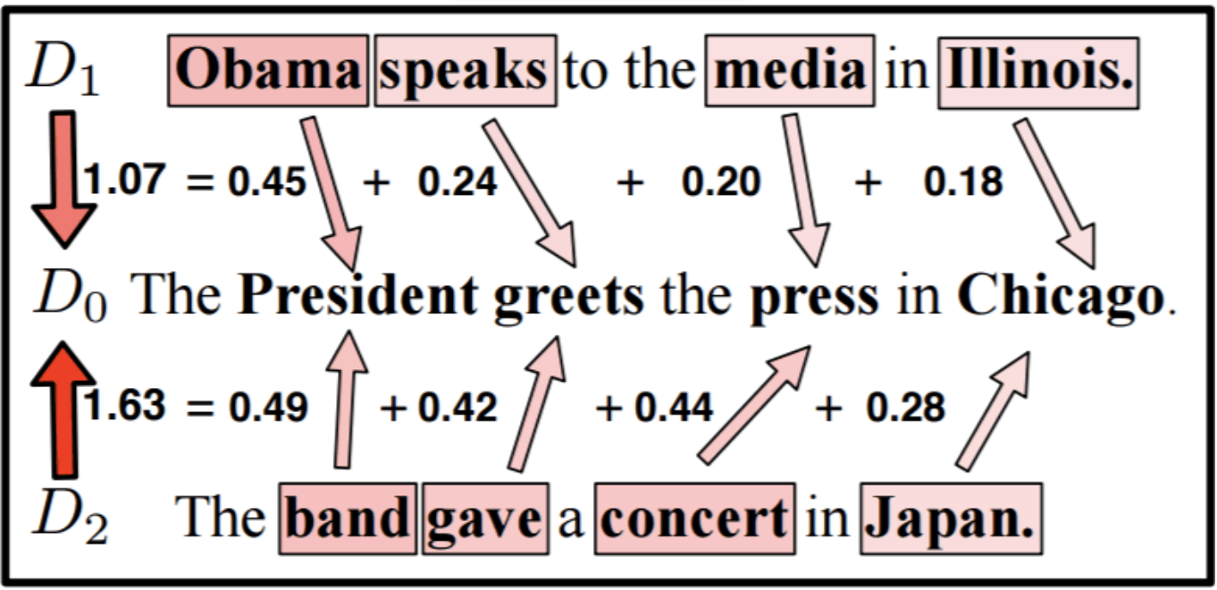
Word Mover’s Distance
Let solve this problem by taking account of the words’ similarities in word embedding space.

Slide 81
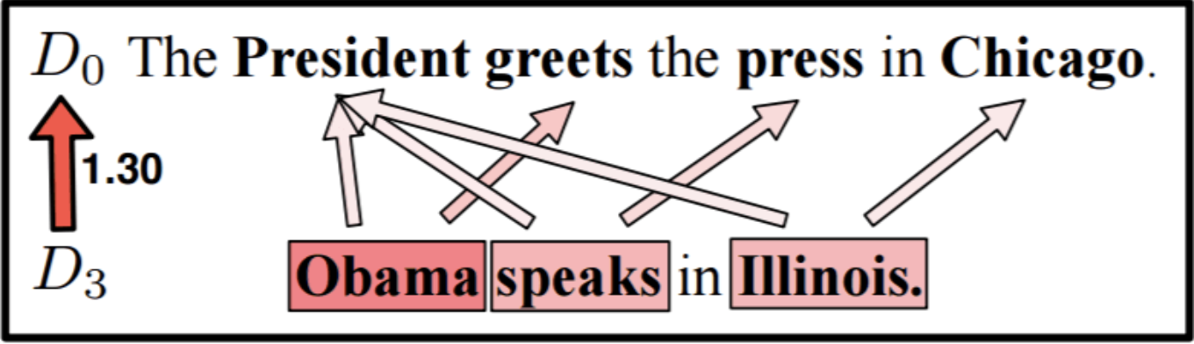
Word Mover’s Distance

Slide 82
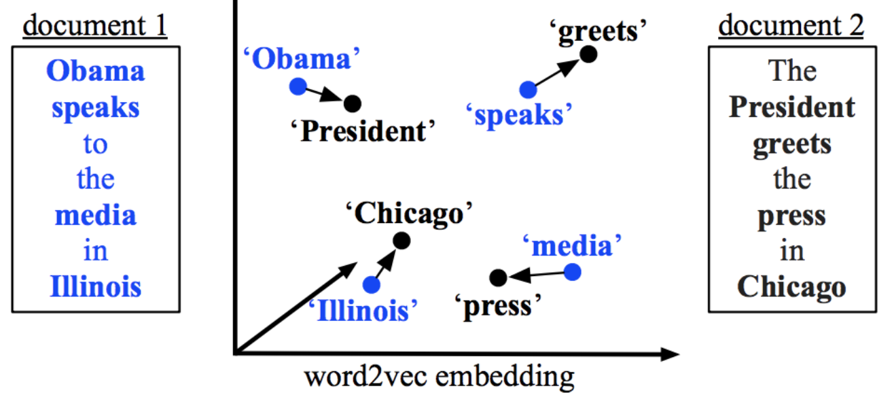
Word Mover’s Distance
Use the word embeddings of the words in two texts to measure the minimum distance that the words in one text need to “travel” in semantic space to reach the words in the other text.

Slide 83
Word Mover’s Distance
Word embeddings of the words in two texts to measure the minimum distance that the words in one text need to “travel” in semantic space to reach the words in the other text.

Slide 84
Outline
Introduction
Comparison Based
Measure of Text Similarity
Syntactical Based
Evaluation
Latent Semantical Based
Knowledge Based
Compositional Approaches
Distributional Based
Distributional Based
Non-compositional Approaches
Contextual Based
Overview

Slide 85
Non-Compositional Measure
Representation of whole texts Similarity computation

Slide 86
Explicit Semantic Analysis for Texts
Document 1
Document 2
 | t₁ | t₂ | t₃ | … | t_{m-1} | t_{m}
d₁ | 3 | 1 | 0 | … | 0 | 0
d₂ | 0 | 5 | 0 | … | 1 | 0
d₃ | 1 | 0 | 2 | … | 3 | 3
… | … | … | … | … | … | …
d_{n-1} | 0 | 2 | 3 | … | 2 | 1
d_{n} | 2 | 3 | 0 | … | 5 | 0
 | t₁ | t₂ | t₃ | … | t_{m-1} | t_{m}
d₁ | 3 | 1 | 0 | … | 0 | 0
d₂ | 0 | 5 | 0 | … | 1 | 0
d₃ | 1 | 0 | 2 | … | 3 | 3
… | … | … | … | … | … | …
d_{n-1} | 0 | 2 | 3 | … | 2 | 1
d_{n} | 2 | 3 | 0 | … | 5 | 0
4
5
4
…
3
5
3
0
4
…
1
2
Inner product
(e.g. cosine similarity)
sim(d₁,d₂) = 0.59
Notes:
Concept vector based measures can also be visualized using the term-document matrix.
However, we now use term vectors instead of document vectors.

Slide 87
Outline
Introduction
Comparison Based
Measure of Text Similarity
Syntactical Based
Evaluation
Latent Semantical Based
Knowledge Based
Compositional Approaches
Distributional Based
Distributional Based
Non-compositional Approaches
Contextual Based
Overview

Slide 88
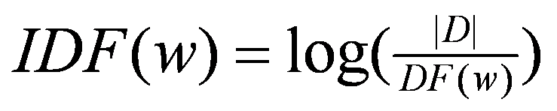
TF.IDF Term Weighting
common words influence the similarity too much
“The king is here.” vs. “The salad is cold.”
solution: weigh words for “importance”
TF(w,d) – Term Frequency
the number of times word w occurs in document d.
DF(w) – Document Frequency
the number of documents in which the word w occurs
IDF(w) – Inverse Document Frequency
Largest value for terms that occur often in a certain document, but cannot be found in other documents
Notes:
Die Vorkommenshäufigkeit (auch Suchwortdichte genannt) gibt an, wie häufig der Term t im Dokument D vorkommt.
Die inverse Dokumenthäufigkeit misst die allgemeine Bedeutung des Terms für die Gesamtmenge der betrachteten Dokumente
Tfidf: Beurteilung der Relevanz von Termen in Dokumenten einer Dokumentenkollektion eingesetzt.
Mit der so errechneten Gewichtung eines Wortes bezüglich des Dokuments, in welchem es enthalten ist, können Dokumente als Suchtreffer einer wortbasierten Suche besser in der Trefferliste angeordnet werden, als es beispielsweise über die Termfrequenz allein möglich wäre

Slide 89
Replace TF scores with TF-IDF values
Document 1
Document 2
 | t₁ | t₂ | t₃ | … | t_{m-1} | t_{m}
d₁ | 0.4 | 0.11 | 0 | … | 0 | 0
d₂ | 0 | 0.5 | 0 | … | 0.21 | 0
d₃ | 0.21 | 0 | 0.2 | … | 0.3 | 0.23
… | … | … | … | … | … | …
d_{n-1} | 0.0 | 0.22 | 0.3 | … | 0.22 | 0.31
d_{n} | 0.22 | 0.3 | 0 | … | 0.35 | 0
 | t₁ | t₂ | t₃ | … | t_{m-1} | t_{m}
d₁ | 0.4 | 0.11 | 0 | … | 0 | 0
d₂ | 0 | 0.5 | 0 | … | 0.21 | 0
d₃ | 0.21 | 0 | 0.2 | … | 0.3 | 0.23
… | … | … | … | … | … | …
d_{n-1} | 0.0 | 0.22 | 0.3 | … | 0.22 | 0.31
d_{n} | 0.22 | 0.3 | 0 | … | 0.35 | 0
0.55
0.5
0.44
…
0.533
0.52
0.4
0
0.44
…
0.31
0.22
Inner product
(e.g. cosine similarity)
sim(d₁,d₂) = 0.79
Notes:
Concept vector based measures can also be visualized using the term-document matrix.
However, we now use term vectors instead of document vectors.

Slide 90
Outline
Introduction
Comparison Based
Measure of Text Similarity
Syntactical Based
Evaluation
Latent Semantical Based
Knowledge Based
Compositional Approaches
Distributional Based
Distributional Based
Non-compositional Approaches
Contextual Based
Overview

Slide 91
Sparse Vectors
What if m and n is very large number?
the real matrix is much larger (e.g. 50,000 x 50,000)
sparse matrix (most values are 0)
 | t₁ | t₂ | t₃ | … | t_{m-1} | t_{m}
d₁ | 3 | 1 | 0 | … | 0 | 0
d₂ | 0 | 5 | 0 | … | 1 | 0
d₃ | 1 | 0 | 2 | … | 3 | 3
… | … | … | … | … | … | …
d_{n-1} | 0 | 2 | 3 | … | 2 | 1
d_{n} | 2 | 3 | 0 | … | 5 | 0
Notes:
Shouldn’t we show the context?

Slide 92
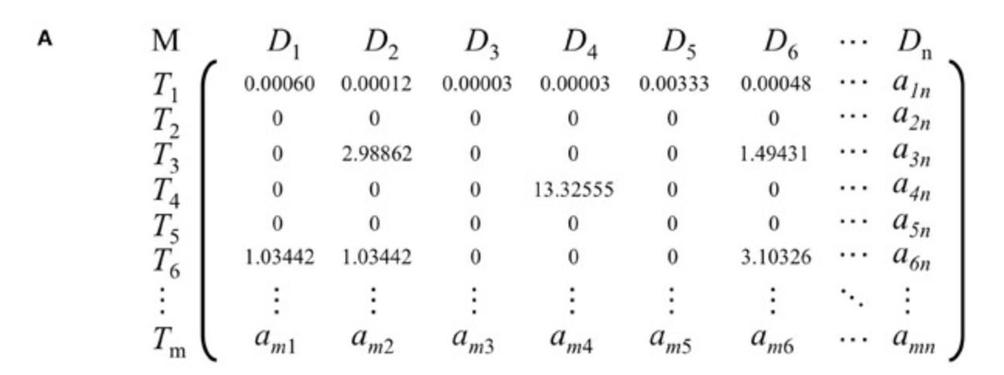
Latent Semantic Indexing (LSI)
Not directly comparing the cosine similarity of bag-of-word vectors, but first reducing the dimensionality of our document vectors by applying latent semantic analysis.
Notes:
Challenge in natural language: ambiguity

Slide 93
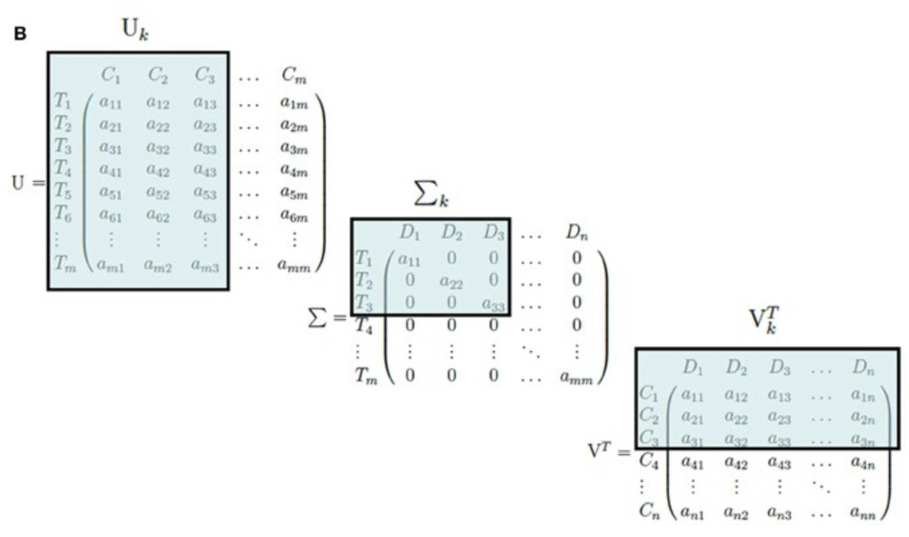
Latent Semantic Indexing (LSI)
Notes:
Challenge in natural language: ambiguity

Slide 94
Latent Semantic Indexing (LSI)
It is often assumed that the underlying semantic space of a corpus is of a lower dimensionality than the number of unique tokens.
Therefore, LSA applies principal component analysis on our vector space and only keeps the directions in our vector space that contain the most variance (i.e. those directions in the space that change most rapidly, and thus are assumed to contain more information).

Slide 95
Example
Suppose we have 3 documents :
d1 = “Shipment of gold damaged in a fire”
d2 = “Delivery of silver arrived in a silver truck”
d3 = “Shipment of gold arrived in a truck”
Goal of the game : We want to find the most similar doc when it comes to the query: “gold silver truck”
Method : Use Latent Semantic Indexing (LSI). We use the term frequency as term weights and query weights.

Slide 96
Step 0
Pre-processing:
Stop words were not ignored
Text was tokenized and lowercased
No stemming was used
Terms were sorted alphabetically
D1: (a, damaged, fire, gold, in of shipment)
D2: (a, arrived, delivery, in , of silver, truck)
D3: (a arrived gold in of shipment truck)
Q: (gold, silver, truck)

Slide 97
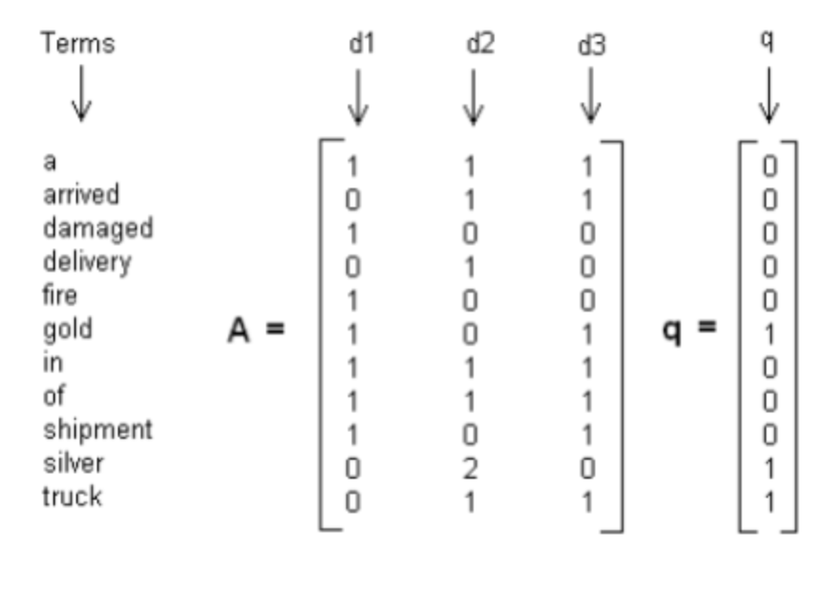
Step 1
Set term weights and construct the term-document matrix A and query matrix

Slide 98
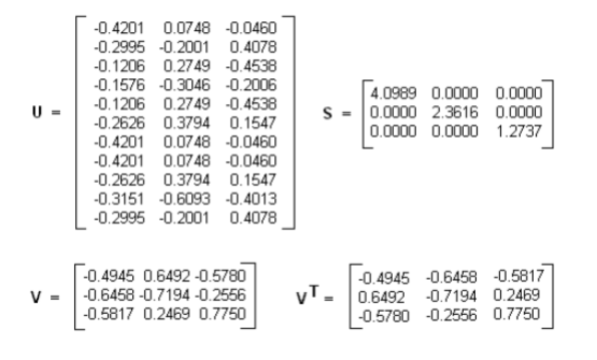
Step 2
Decompose matrix A matrix and find the U, S and V matrices, where A = U S (V)^{T}

Slide 99
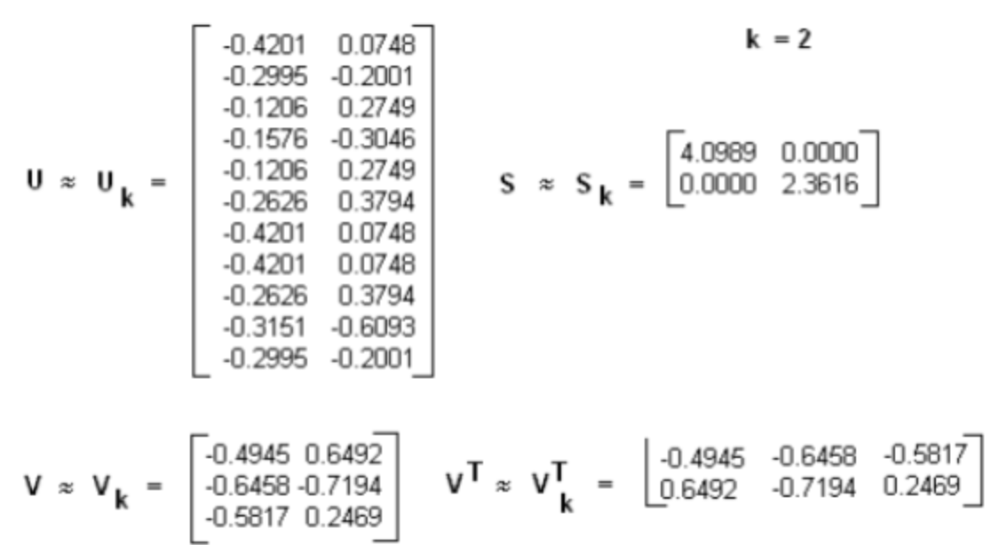
Step 3
Implement a Rank 2 Approximation by keeping the first two columns of U and V and the first two columns and rows of S.

Slide 100
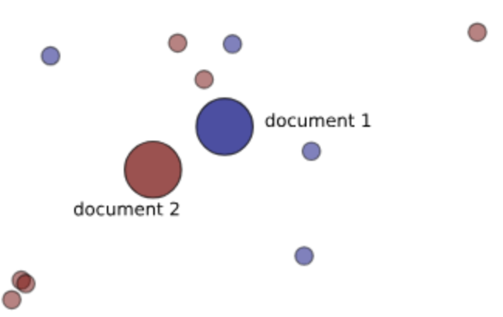
Step 4
Find the new document vector coordinates in this reduced 2-dimensional space
Rows of V holds eigenvector values. These are the coordinates of individual document vectors, hence
d1 = (-0.4945, 0.6492)
d2 = (-0.6458, -0.7194)
d3 = (-0.5817, 0.2469)

Slide 101
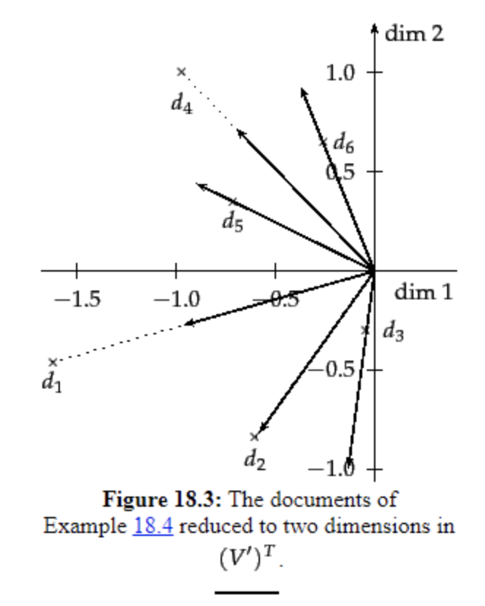
Step 5
Find the new query vector coordinates in the reduced 2-dimensional space.

Slide 102
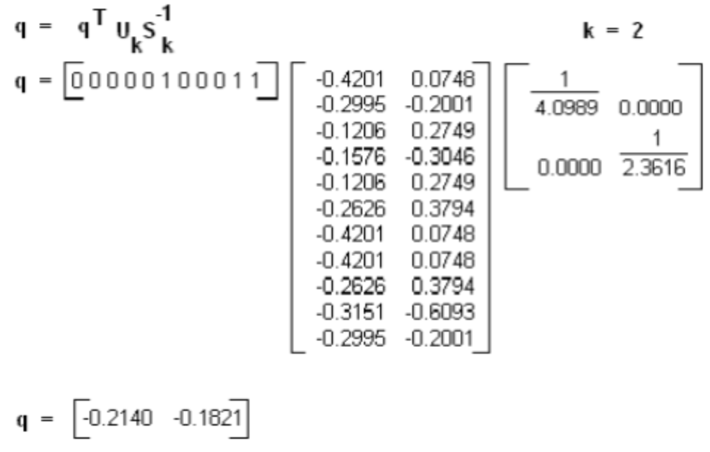
Step 5
These are the new coordinate of the query vector in two dimensions. Note how this matrix is now different from the original query matrix q given in Step 1.

Slide 103
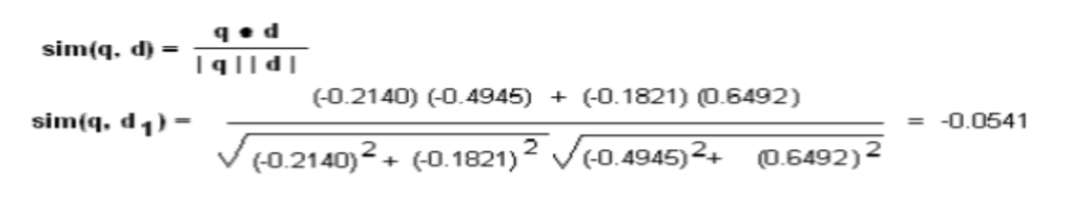
Step 6
Rank documents in decreasing order of query-document cosine similarities.

Slide 104
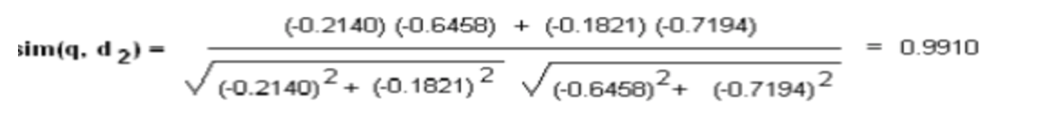
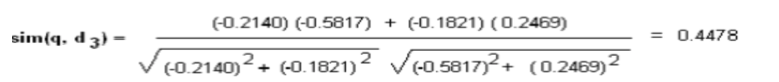
Step 6
Rank documents in decreasing order of query-document cosine similarities.

Slide 105
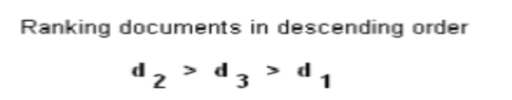
Conclusion
We can see that document d2 scores higher than d3 and d1. Its vector is closer to the query vector than the other vectors.

Slide 106
Outline
Introduction
Comparison Based
Measure of Text Similarity
Syntactical Based
Evaluation
Latent Semantical Based
Knowledge Based
Compositional Approaches
Distributional Based
Distributional Based
Non-compositional Approaches
Contextual Based
Overview

Slide 107
The look and feel of word representations
...
wiegen 0.0427915 -0.401344 -0.0667862 0.21649 0.00169907 -0.0687786 -0.195405 -0.0534437 -0.676733 -0.23975 -0.159674 -0.0402676 -0.0617923 0.284718 0.358523 -0.285709 -0.00736682 -0.254635 -0.22907 -0.186109 ...
einlegen 0.365857 -0.0339146 0.198442 -0.0961315 0.156193 0.253468 0.169963 -0.232588 -0.422901 -0.0750184 0.0236783 0.249385 -0.0122247 -0.584567 -0.0711365 0.254896 0.382103 0.352294 0.825432 0.277691 0.773015 ...
sprengstoff 0.06961 0.118456 0.00497905 0.581913 -0.326157 -0.0674812 -0.0926074 -0.254514 -0.458406 -0.225093 0.0424881 -0.142328 -0.138707 0.481305 0.183707 -0.626077 0.396159 0.156636 0.157851 -0.441935...
vulkan 0.0322022 -0.429981 0.352328 -0.0530384 -0.366048 0.44187 -0.265227 -0.223954 -0.369078 -0.203064 0.158458 0.169517 0.448234 0.497058 -0.20855 0.046978 0.180444 0.290595 0.00907329 0.130582 0.0378717 -0.339296 0.399039...
...
Notes:
Examples from Nils vocab file
Make the point: How do we know this is useful? Not interpretable. And what do we do with it?

Slide 108
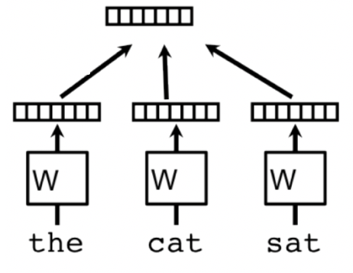
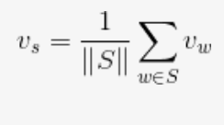
Embedding Vector
Average/Concatenate
Distributional approach where sentence vector is average or concatenation of embedding vectors of each of the word available in the sentence.
Mathematically,

Slide 109
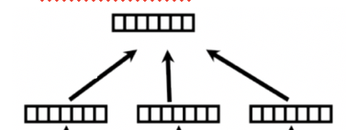
Explicit Semantic Analysis for Texts (III)
Document 1
Document 2
term1
term2
term3
term1
term2
4
5
4
…
3
5
3
0
4
…
1
2
Inner product
(e.g. cosine similarity)
sim(d₁,d₂) = 0.79
Notes:
Concept vector based measures can also be visualized using the term-document matrix.
However, we now use term vectors instead of document vectors.

Slide 110
Problems with similarity evaluations
Faruqui et al. (2016): Problems with Evaluation of Word Embeddings Using Word Similarity Tasks
What kind of (semantic) similarity is being measured? → Cup and coffee are related, but not similar
Low correlation with extrinsic evaluation: Better intrinsic word vectors do not need to perform better in external tasks such as POS tagging.
Polysemy: Which sense of a word is being compared?
Notes:
Usually, embeddings are either better at semantic tasks or at syntactic tasks

Slide 111
Problems with similarity evaluations
The similarity of two words depends on the context in which they are presented.
In the context of abortion, the words body and decision are rated to be highly similar.
Notes:
Usually, embeddings are either better at semantic tasks or at syntactic tasks

Slide 112
Smooth Inverse Frequency
Taking the average of the word embeddings in a sentence tends to give too much weight to words that are quite irrelevant, semantically speaking.
Example:
Nory was a Catholic because her mother was a Catholic, and Nory’s mother was a Catholic because her father was a Catholic, and her father was a Catholic because his mother was a Catholic, or had been.
Equal weightage to each of the term in the above sentence supress the importance of terms like mother, father, etc.

Slide 113
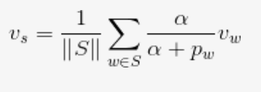
SIF Embeddings
Smooth Inverse Frequency provided the solution where it computes sentence embeddings as a weighted average of word vectors
Instead of just averaging the component word vectors, sentence vector v_{s} is generated by multiplying each component vector v_{w} by the inverse of its probability of occurrence (p_{w}) .
where a is a parameter that is typically set to 0.001

Slide 114
PV-DM (Doc2Vec)
Also called Paragraph vectors.
Unlike word2vec, we aims at learning how to project a document into a latent d-dimensional space.
randomly sample consecutive words from a paragraph and predict a center word from the randomly sampled set of words by taking as input - the context words and a paragraph id.

Slide 115

PV-DM (Doc2Vec)
Paragraph matrix is the matrix where each column represents the vector of a paragraph.

Slide 116
Outline
Introduction
Comparison Based
Measure of Text Similarity
Syntactical Based
Evaluation
Latent Semantical Based
Knowledge Based
Compositional Approaches
Distributional Based
Distributional Based
Non-compositional Approaches
Contextual Based
Overview

Slide 117
Contextualized Embeddings
Provide context dependency to word vector.
For example:
apple has a different semantic meaning in each sentence.
With a contextualized language model, the embedding of the word apple would have a different vector representation which makes it even more powerful for NLP tasks.
I like apples.
I like Apple macbooks

Slide 118

Autoencoders

Slide 119
Autoencoders
An AutoEncoder takes an input (sequence of text in our case), squeezes it through a bottleneck layer (which has less nodes than the input layer), and output it to a decoder which tries to reconstruct the exact same input
This approach allows us to learn vectors representations to any unstructured text, of any length. We control the size of the bottleneck layer, which means we control the size of the embeddings vectors we want to generate.
After Training the AutoEncoder, we can use the encoder model to generate embeddings to any input.

Slide 120

Transformers
The idea of training a separate language model to produce better contextual word representation has proved very successful in improving efficiency many NLP tasks.

Slide 121

Transformer - Encoder
Like autoencoders, transformer include encoder and decoder units.
Each Encoder include Self-attention network and feed forward networks.

Slide 122

Transformer - Decoder
Each Decoder include Self-attention, Cross-attention and feed forward networks.
Input from Encoder

Slide 123

Transformer Visualization

Slide 124

BERT
Use the transformer block to train a language model using a masking technique where the system isn’t tasked with guessing the next word but rather one of the words masked out in the sentence. This way it is able to use the entire context for prediction and not only the left context.

Slide 125

BERT

Slide 126

Choose Your Token‘s Embedding Vector
The Output of each encoder layer along eac token‘s path can be used as a feature representing that token.

Slide 127

Pre-trained Models layers as Sentence representation
Assume D_{s} = D_{T}

Slide 128
Pre-trained Models layers as Sentence representation
Deep learning systems and models are layered architectures that learn different features at different layers (hierarchical representations of layered features).
Key idea : leverage the pre-trained model’s weighted layers to extract features but not to update the weights of the model’s layers during training with new data for the new task.

Slide 129
Outline
Introduction
Comparison Based
Measure of Text Similarity
Syntactical Based
Evaluation
Latent Semantical Based
Knowledge Based
Compositional Approaches
Distributional Based
Distributional Based
Non-compositional Approaches
Contextual Based
Overview

Slide 130
Overview
Text Similarity
Syntactical/TF-IDF
Latent Semantic/LSI
Compositional
Non-compositional
Sentence/Document based
Learned representation/Doc2Vec
Token-based
Contexual /Transformer
Comparison based /Jaccard
Knowledge-based/wordnet
Learned representation/Word2vec

Slide 131
Further Readings
Wael H. Gomaa, A Survey of Text Similarity Approaches.
Bär, Daniel. A Composite Model for Computing Similarity Between Texts. Diss. Technische Universität, 2013., Chapter 3,4 and 8

Slide 132
References
https://medium.com/@adriensieg/text-similarities-da019229c894
http://nlp.town/blog/sentence-similarity/
https://medium.com/mlreview/implementing-malstm-on-kaggles-quora-question-pairs-competition-8b31b0b16a07
http://www1.se.cuhk.edu.hk/~seem5680/lecture/LSI-Eg.pdf
https://markroxor.github.io/gensim/static/notebooks/WMD_tutorial.html
https://www.machinelearningplus.com/nlp/cosine-similarity/
http://poloclub.gatech.edu/cse6242/2018spring/slides/CSE6242-820-TextAlgorithms.pdf
https://github.com/makcedward/nlp/blob/master/sample/nlp-word_embedding.ipynb
http://robotics.stanford.edu/~scohen/research/emdg/emdg.html#flow_eqw_notopt

Slide 133
References
http://robotics.stanford.edu/~rubner/slides/sld014.htm
http://jxieeducation.com/2016-06-13/Document-Similarity-With-Word-Movers-Distance/
http://stefansavev.com/blog/beyond-cosine-similarity/
https://www.renom.jp/index.html?c=tutorial
https://weave.eu/le-transport-optimal-un-couteau-suisse-pour-la-data-science/
https://hsaghir.github.io/data_science/denoising-vs-variational-autoencoder/
https://www.jeremyjordan.me/variational-autoencoders/
https://www.kaggle.com/shivamb/how-autoencoders-work-intro-and-usecases
http://www.erogol.com/duplicate-question-detection-deep-learning/
Notes:
McCormick, C. (2017, January 11). Word2Vec Tutorial Part 2 - Negative Sampling.
word2vec Parameter Learning Explained, Xin Rong
https://code.google.com/archive/p/word2vec/
Stanford NLP with Deep Learning: Lecture 2 - Word Vector Representations: word2vec

Slide 134
Take-Home-Messages
Text/Sentence/Document/Paragraph.. similarity determines the strength of relationship between two sentences or documents.
Compositional based text similarity:
BoW / Term Frequency.
Jaccard/ Knowledge based / Word2vec
Non- Compositional based text similarity:
TF-IDF/ LSI/ Embeddings/ Transformer – BERT /Clustering
Evaluation Criteria:
Bleu/ Rouge

